Slide 1
OPTIMIZING CUSTOMER BOOKING
Unveiling Patterns and Strategies with British Airways

Slide 2
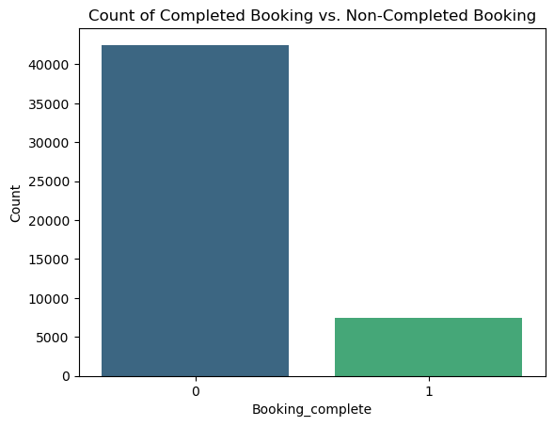
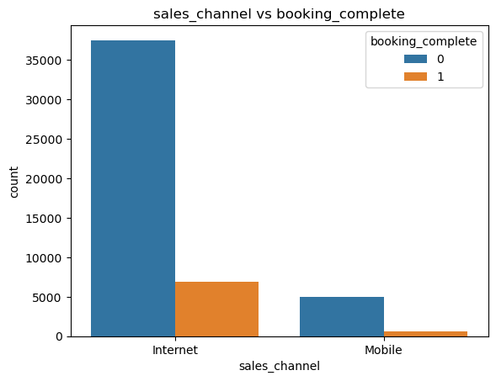
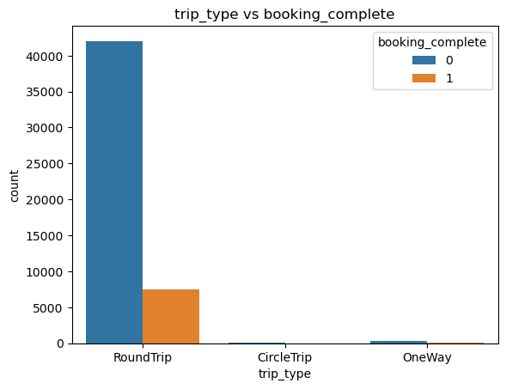
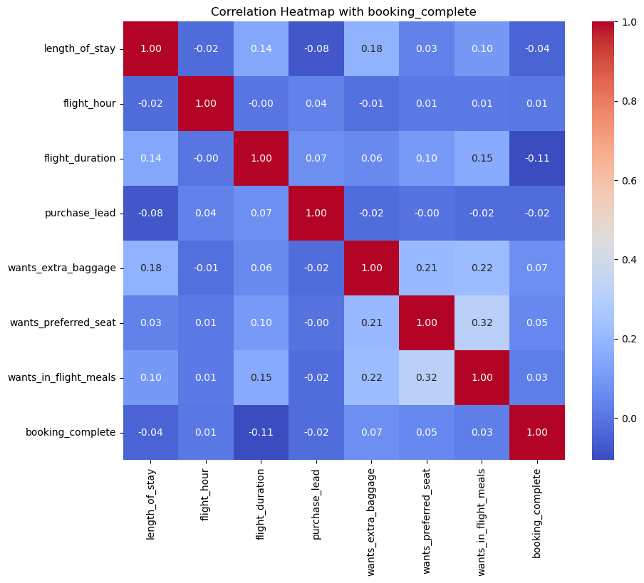
ANALYSIS
Booking Completion Analysis:
The majority of bookings(47,000) were not completed compared to completed bookings(8,000). This suggests the need to explore factors influencing booking completion.
Sales Channel Impact:
Internet bookings shows a significant completion rate(7000), indicating a strong channel. Mobile bookings, however, exhibit a lower completion rate(500), suggesting potential areas for improvement.
Trip Type Influence:
Customers prefer round trips, with a completion ration of 7,500. The low completion for one-way trips indicates a possible area of concern or an opportunity for targeted marketing.
Correlation Heat Map Insights:
Features positively correlated with completion include desires for extra baggage, preferred seat, and in-flight meals. Negative correlations with flight duration and length of stay may suggest customer prefer shorter flights and stays.
Random Forest Model:
An 85% accuracy of Random Forest model was built, which indicates it’s effectiveness in predicting booking outcomes and a valuable tool to guide marketing strategies.
Overall Implications:
To enhance completion rates, focus on optimizing the mobile booking experience.
Emphasize round trip offerings, potentially through targeted promotions.
Consider promoting features like extra baggage and preferred seats to boost completion rates.
Acknowledge the importance of flight duration and length of stay in customer decision-making.

